Slide 1
Submission - Lending Club Case Study
Group Members:
Adway Kirwe
Abhinav Mishra

Slide 2
Case Study Objectives
The Lending company wants to identify that to whom they can extend the loan and to whom they should avoid by analyzing the risk associated:
Risk(s)
If the applicant is likely to repay the loan, then not approving the loan results in a loss of business to the company
If the applicant is not likely to repay the loan, i.e., he/she is likely to default, then approving the loan may lead to a financial loss for the company
Identification of Loan Applicant traits that tend to ‘default’ paying back
Understand the Factors or Variables which may leads to Loan Default
Loan Lending Organizations may choose to utilize this knowledge for its portfolio and risk assessment of new loan applicants

Slide 3
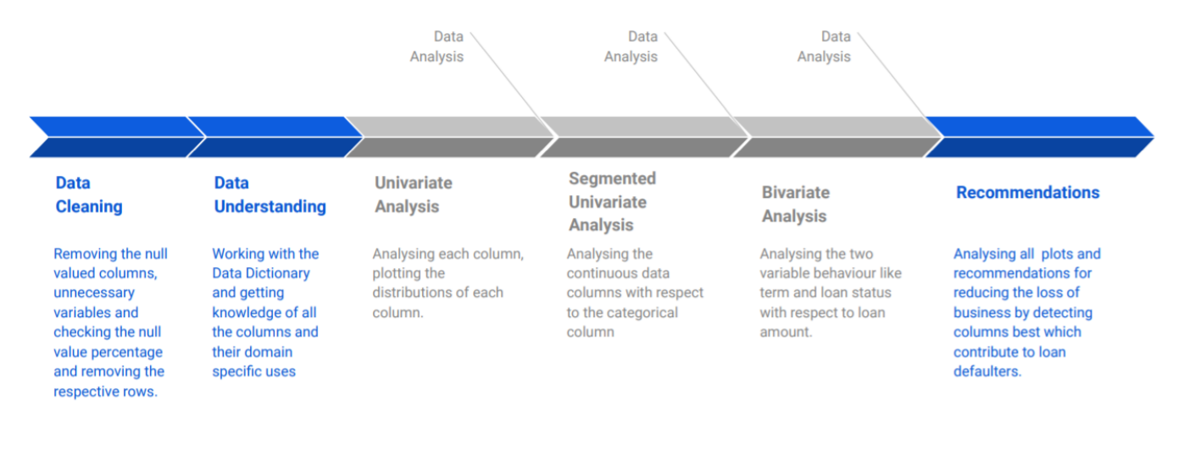
Problem solving methodology

Slide 4
Data Cleaning
Delete all needless columns
Remove the outliers from the data
Treat Missing values with suitable values.
Remove duplicate rows
Remove duplicate columns
Filter rows by segment and filter by date period to get only those rows which are relevant to our analysis.

Slide 5
Analysis
The core of the whole case study is to analyze and understand how consumer attributes and loan attributes are influencing the tendency of defaulting.
After data cleaning created derived columns for analysis.
During univariate analysis we have created Bar and Box charts
Performed the Multivariate analysis to understand how different variables interact with each other.

Slide 6
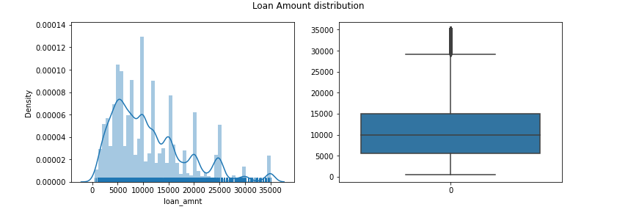
Univariate analysis

Slide 7
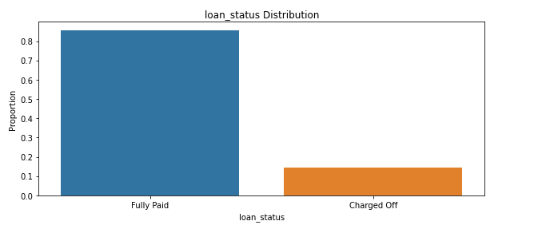
Loan Status Analysis

Slide 8
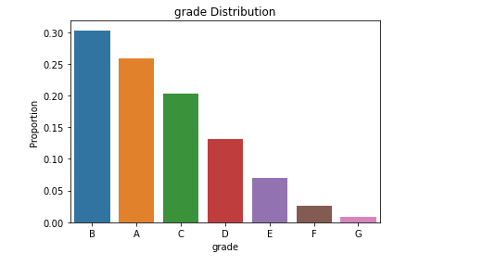
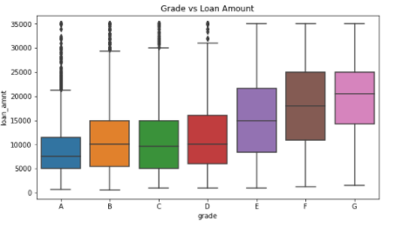
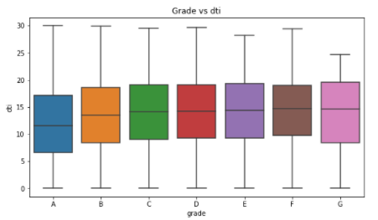
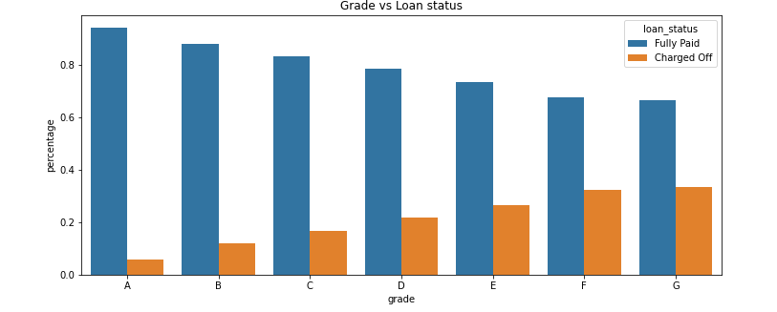
Loan Grade Analysis

Slide 9
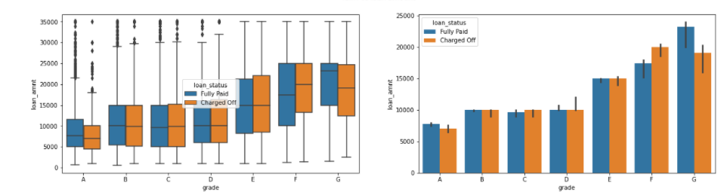
Loan Grade Analysis

Slide 10
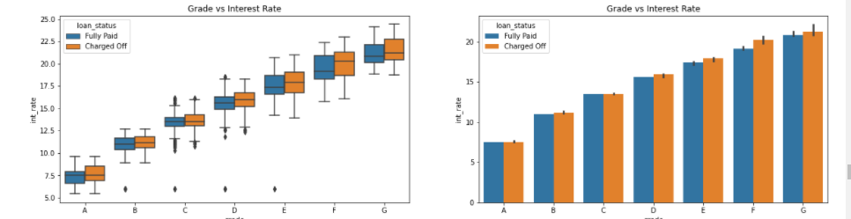
Grade vs Interest rate

Slide 11
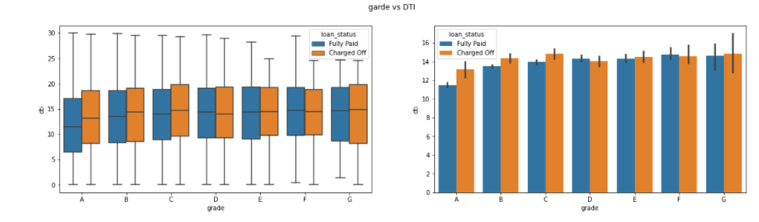
Grade Vs DTI

Slide 12
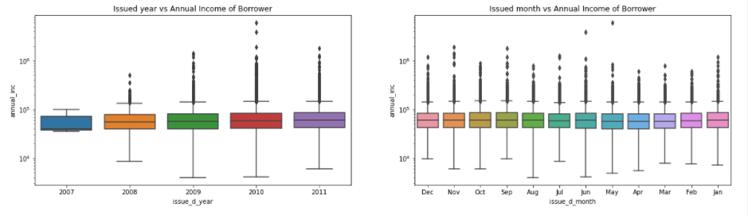
Loan Applicants vs Income of Borrower

Slide 13
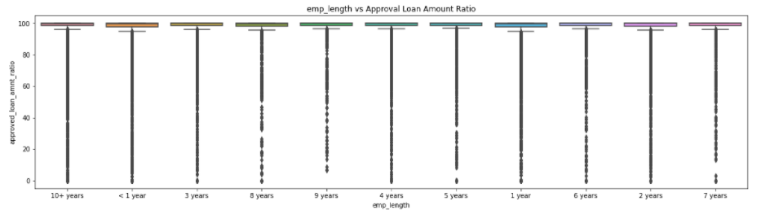
Employment length vs Approval Loan Amount Ratio

Slide 14
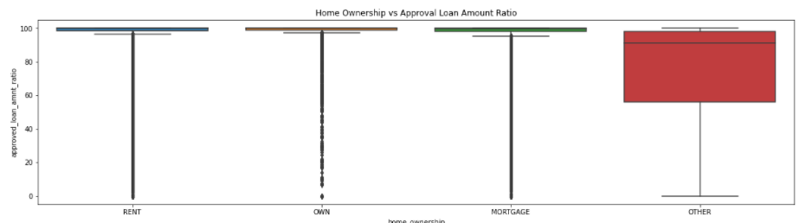
Home Ownership vs Approval Loan Amount Ratio

Slide 15
Conclusion
Grading is an important variable on which Lending Club can detect the defaulters as low-grade loans have more chances to default
Loans having higher interest rate have more defaulters. Lending club should reduce the high interest loans and should verify the background of applicant thoroughly.
In case of debt consolidation also the default tendency is pretty high. As such, Lending club should have a check on that as well.
Region wise as well club should have a control as states like CA and FL, as tendency to default is high.

